Slide 1

MEDISWIFT
Under the guidance of:
Prof. Weider Yu
Team 15:
Anushree, Jaswanth, Siddhartha, Yeshwanth

Slide 2
CONTENTS
INTRODUCTION
DATA SOURCE
OUR WEB APPLICATION
OUR ANDROID APPLICATION
WHO ARE THE USERS?
SYSTEM REQUIREMENTS
SYSTEM DIAGRAM
DATA MODEL
APPLICATION COMPONENTS
FUTURE WORK
CONCLUSION

Slide 3
INTRODUCTION
Rapid increase in Health Hazards
Ambiguity as to:
Whom to approach or consult
Which hospital/doctor to choose(rating)
Proximity of the chosen option
Do they provide the service you need?

Slide 4
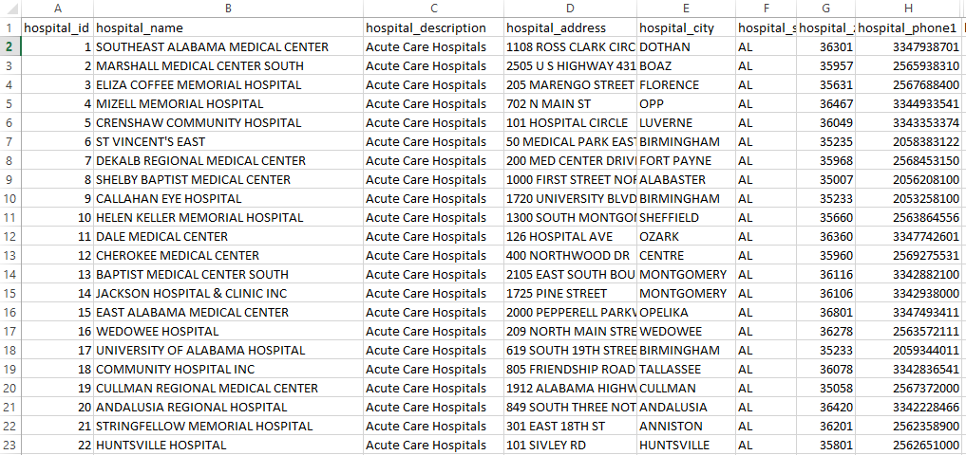
DATA SOURCE
https://data.medicare.gov/data/hospital-compare

Slide 5
WHO ARE THE USERS?
THE PUBLIC
IN CASE OF EMERGENCY
FOR CONSULTATION
GOVERNMENT
STATISTICS
HOSPITAL ADMINISTRATION
REDIRECTING TO A DIFFERENT HOSPITAL/PHYSICIAN
2 . COMPETITIVE MEDICAL CENTRES AROUND THEM

Slide 6
SYSTEM REQUIREMENTS
HARDWARE USED:
i7 PROCESSOR @ 2.5GHz
8GB RAM
1 TB STORAGE

Slide 7
SYSTEM REQUIREMENTS
SOFTWARE/OS USED:
VISUAL STUDIO
MICROSOFT SQL AZURE
MICROSOFT MANAGEMENT STUDIO
WINDOWS 8
MICROSOFT EXCEL

Slide 8
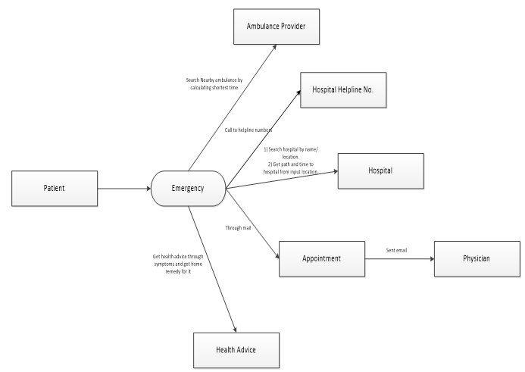
SYSTEM DIAGRAM

Slide 9
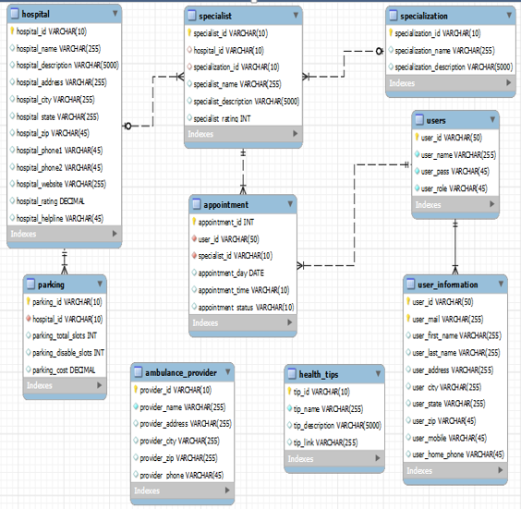
DATA MODEL

Slide 10
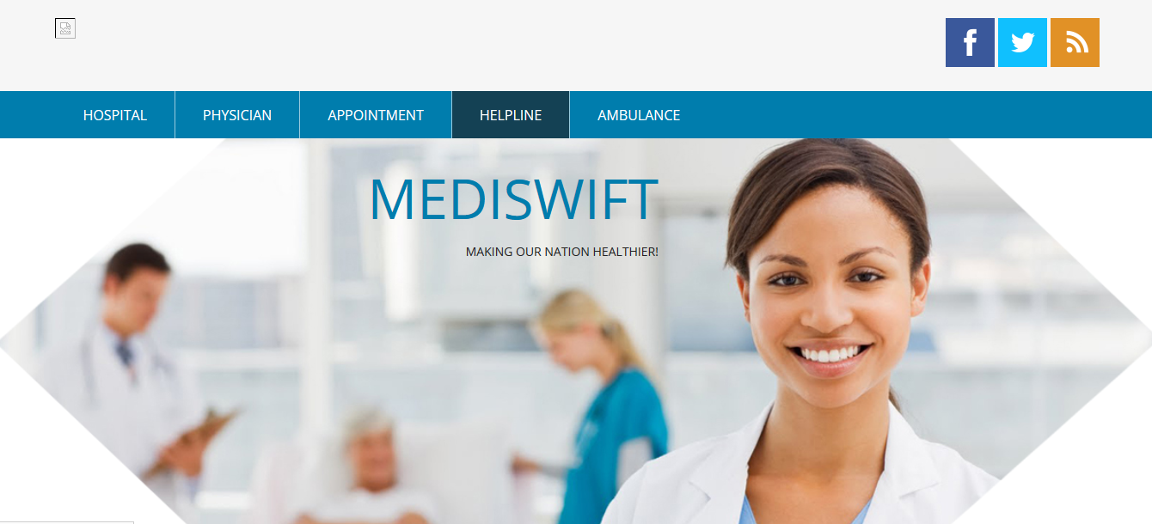
APPLICATION COMPONENTS-HOME

Slide 11
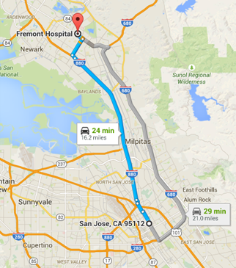
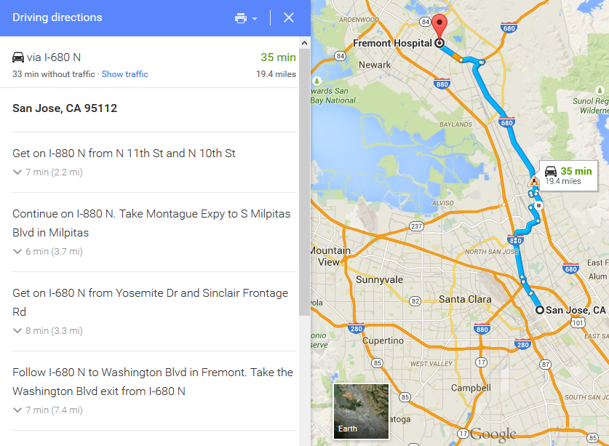
GOOGLE’S SUGGESTION VS CUSTOM ALGORITHM

Slide 12
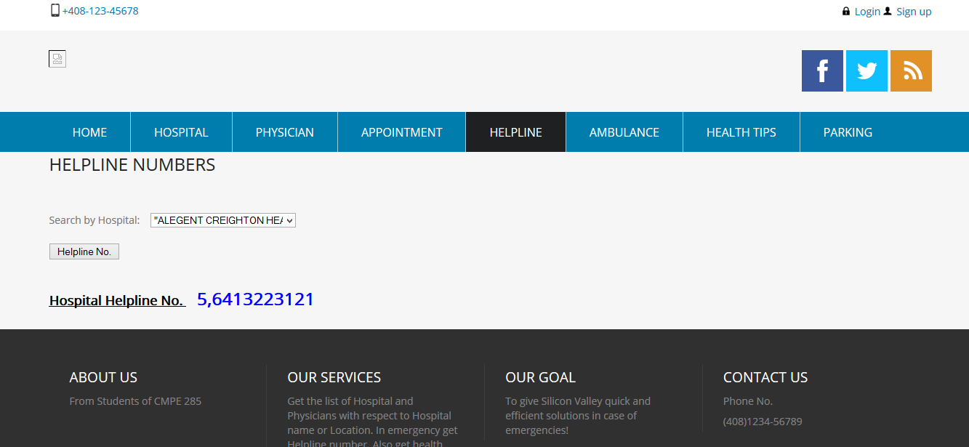
APPLICATION COMPONENTS-HELPLINE

Slide 13
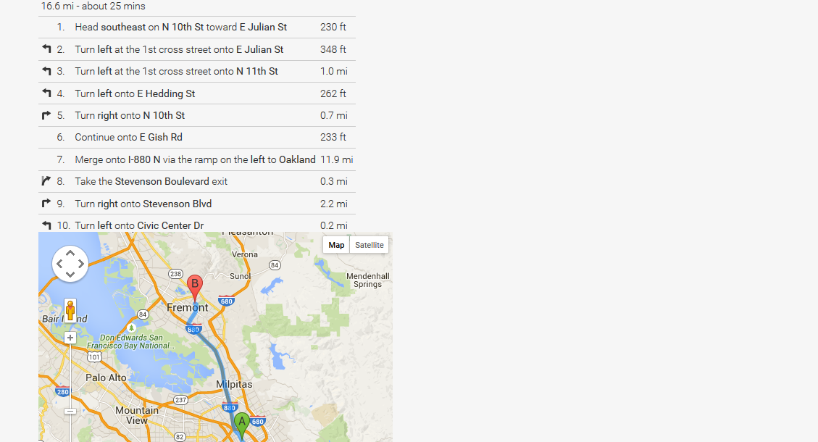
APPLICATION COMPONENTS-LOCATING THE HOSPITAL

Slide 14

BLOOD BANKS

Slide 15
FUTURE WORK – BLOOD BANK
Users: Hospitals, common people, donors
Nearest Blood Bank
Required Blood Group
Banks can request donors through website/app

Slide 16
CONCLUSION
Developed a user-friendly web/android applications for multiple users in need of Medicare.
A handy solution for emergency and consultation purposes.
Real-time medical centers data retrieved.

Slide 17
REFERENCES
http://developer.android.com
http://www.w3schools.com/asp/
http://msdn.microsoft.com/en-us/default.aspx
http://azure.microsoft.com/en-us/
http://www.microsoft.com/en-us/server-cloud/products/sql-server/

